Slide 1
Real-time Multimodal Language Translator
Team Details
D.Namratha (21eg505815)
P.SaiAvaniessh (21eg505855)
B.Bharath (21eg505807)
Project Supervisor
Name:J Himabindu
Priyanka
Assistant Professor

Slide 2
Introduction
In today’s increasingly interconnected world, effective communication across language barriers is fundamental challenge faced by individuals, businesses, and organizations. The ability to understand and be understood in various languages is essential for successful global interactions, whether in travel, business, education,or personal communication. To address this challange, we have developed the “Real-time Multimodal Language Translator” project. A cutting-edge solution that leverages both voice recognition and image text extraction to provide real-time, accurate translations in a user-friendly interface.

Slide 3
Literature
Author(s) | Method | Advantages | Disadvantages
Takatomo Kano, Sakriani Sakti, Satoshi Nakamura | the learning scheme changes from single-task to multi-task learning | Naturalness,End-to-End Processing,Multilingual Support,Fine-Tuning | Data Requirements,Errors,Privacy and Security,Resource-Intensive Decoding
Naveen Arivazhagan, Colin Cherry, I Te, Wolfgang Macherey, Pallavi Baljekar, George Foster | NMT heuristics in our English-to-German TED Talk simultaneous spoken language translation scenario | Improved Accuracy,Enhanced Clarity,Confidence Building | Potential for Delays,Potential for Error Propagation,Audience Perception
Muhammad Ajmal,Farooq Ahmad,Martinez-Enriquez A.M.,Mudasser Naseer,Aslam Muhammad | Device camera will start automatically and user can focus and take a snapshot of text easily | Multilingual Accessibility,Customization ,Scalability,Language Preservation | Quality of Conversion,Loss of Visual Information,Linguistic and Cultural Sensitivity,Quality Control

Slide 4
Problem Statement
The problem statement for real-time voice and image translator project addresses the pressing need to bridge language barriers in real-time communication scenarios,including voice conversations and text extracted from images.In today’s world, people frequently encounter situations where language differences hinder effective communication. Whether in business mettings, travel, or social interactions, the inability to understand and respond to a foreign language poses significant challenges.
Objective
The objective of a project focused on developing a real-time voice and image translator is to create a comprehensive system that seamlessly translates spoken language and text within images, enhancing communication and breaking down language barriers. The project's objectives encompass various aspects like Speech Recognition, Image Processing, Privacy and Data Security, Accuracy and Naturalness, Real-Time Perform

Slide 5
Proposed Method
To Develop a real-time multimodal language translator application that can perform the following tasks:
Voice Translation:
Capture and translate spoken language (voice) from the user in real-time.
Support recognition and translation of spoken language into multiple target languages.
Provide an intuitive user interface for voice input and output translation.
Image Text Translation:
Allow users to upload images containing text from their device's gallery.
Extract text content from the uploaded images using Optical Character Recognition (OCR) technology.
Translate the extracted text into the user's preferred language.

Slide 6
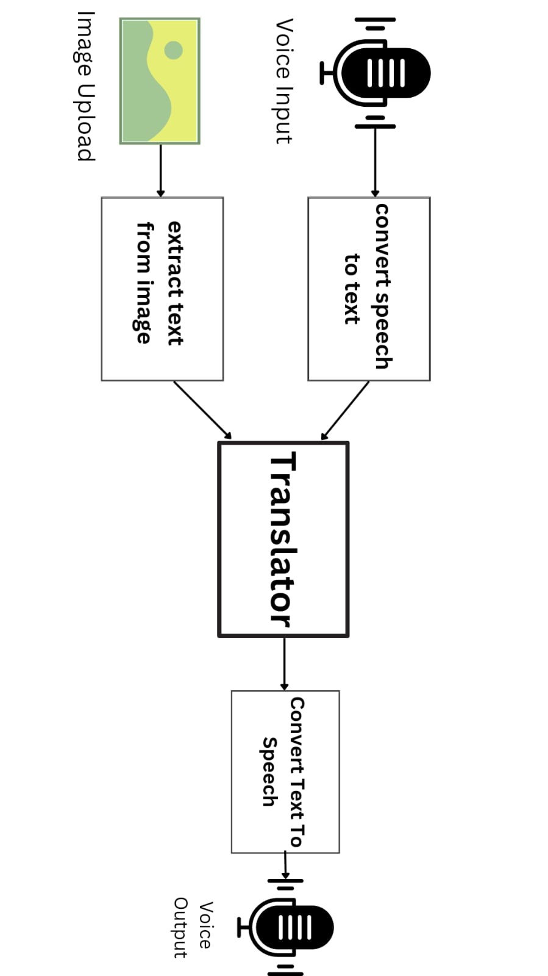
Proposed Method

Slide 7
Project status
S.No | Functionality | Status (Completed /in-progress/Not started)
1. | Searched IEEE papers on this project | completed
2. | Probelm Statement | completed
3. | Literature survey | completed
4. | Design | in-progress
5. | Implementation | in-progress

Slide 8
References
[1] Takatomo Kano, Sakriani Sakti, Satoshi Nakamura”Transformer-Based Direct Speech-To-Speech Translation with Transcoder” 2021 IEEE Spoken Language Technology Workshop(SLT) | 978-1-7281-7066-4/20/$31.00 @2021 IEEE | DOI: 10.1109/SLT48900.2021.9383496
[2] Naveen Arivazhagan, Colin Cherry, I Te, Wolfgang Macherey, Pallavi Baljekar, George Foster “Re-Translation Strategies for Long Form, Simultaneous, Spoken Language Translation” 2020 IEEE Xplore | 978-1-5090-6631-5/20/$31.00 @2020 IEEE | DOI: 10.1109/ICASSP40776.2020.9054585
[3] Muhammad Ajmal,Farooq Ahmad,Martinez-Enriquez A.M.,Mudasser Naseer,Aslam Muhammad,Mohsin Ashraf “Image to Multilingual Text Conversion for Literacy Education”2020 17th IEEE International Conference on Machine Learning and Applications | DOI:10.1109/ICMLA.2020.00215

